Slide 1
BITS Pilani presentation
Mridul Moitra
Cloud Computing

Slide 2
<CSI ZG527 / SS ZG527 / SE ZG527
Cloud Computing
Lecture No. 3

Slide 3
Difference between RISC and CISC −
Microprocessors are classified based on the architecture (instruction set) into RISC and CISC.
RISC
It stands for Reduced Instruction Set Computer.
It is a microprocessor architecture that uses small instruction set of uniform length.
These simple instructions are executed in one clock cycle.
These chips are relatively simple to design.
They are inexpensive.
The disadvantage is that the computer has to repeatedly perform simple operations in order to execute a large program that has a large number of processing operations.
Examples of RISC chips include SPARC, POWER PC.
It has less number of instructions.
It has fixed-length encodings for instructions.
Simple addressing formats are supported.
It doesn’t support arrays.
It doesn’t use condition codes.
Registers are used for procedure arguments and return addresses.

Slide 4
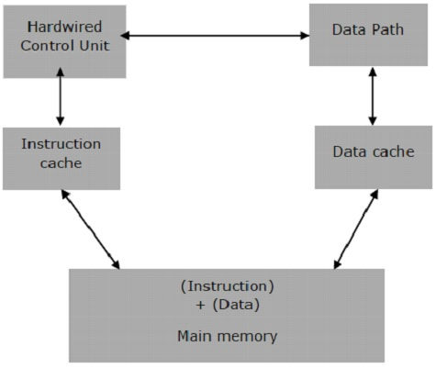

Slide 5
CISC
It stands for Complex Instruction Set Computer.
This offers hundreds of instructions of different sizes to the users.
This architecture has a set of special purpose circuits which help execute the instructions at a high speed.
The instructions interact with memory using complex addressing modes.
These processors reduce the size of the program.
Consequently, they take less number of memory cycles to execute the programs.
The overall speed of execution is high.
Examples of CISC include Intel architecture, AMD.
It has variable-length encodings of instructions.
It supports array.
It has a large number of instructions.
Arithmetic and logical operations can be applied to memory and register operands.
Condition codes are used.
The stack is used for procedure arguments and return addresses.

Slide 6
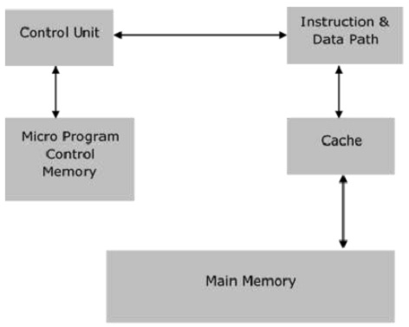
Architecture of CISC

Slide 7
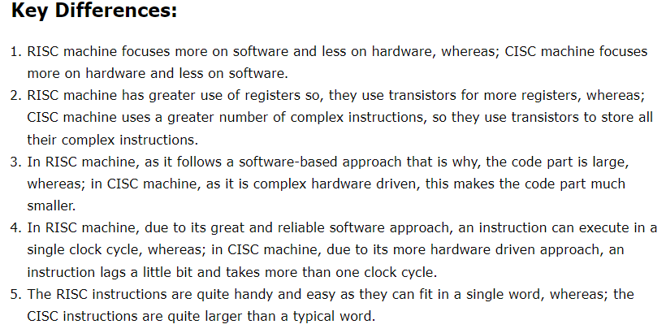

Slide 8
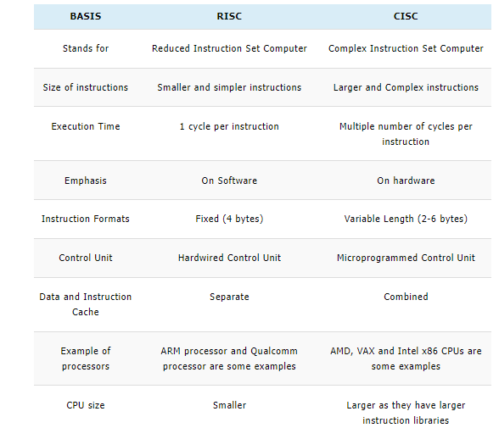
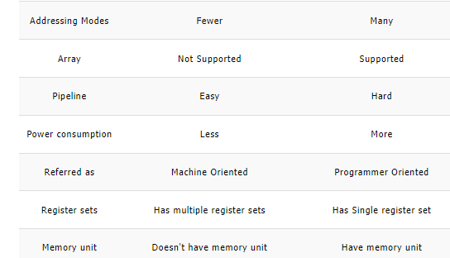

Slide 9
Cloud Security Architecture Patterns
Cloud Security Architecture Patterns
The right pattern can help you implement security across your organization. For example, it can help you protect the CIA (confidentiality, integrity, and availability) of your cloud data assets, as well as respond to security threats. You can implement security controls directly, or use security controls as a service offered by your cloud provider or third-party vendors.
The cloud security architecture model is usually expressed in terms of:
Security controls—which can include technologies and processes. Controls should take into account the location of each service—company, cloud provider, or third party.
Trust boundaries—between the different services and components deployed on the cloud
Standard interfaces and security protocols—such as SSL, IPSEC, SFTP, LDAPS, SSH, SCP, SAML, OAuth, etc.)
Techniques used for token management—authentication, and authorization
Encryption methods including algorithms like 128-bit AES, Triple DES, RSA, Blowfish.
Security event logging—ensuring all relevant security events are captured, prioritized, and delivered to security teams.
Here are a few best practices that you can follow to enhance the security of your cloud-based assets:
Enforce policies and data governance:
It is entirely the enterprise’s responsibility to put in place and enforce policies for cloud data ownership and responsibility. At the most basic level, the enterprise must understand and classify its data so that the appropriate security measures can be implemented according to the varying levels of data sensitivity.
Diligently manage identity and access controls:
Identity and access management (IAM) in the cloud is substantially more complex than it is in closed, monolithic environments. Cloud providers offer best practice guidelines as well as tools and managed services to help organizations handle IAM, but it’s up to the organization to use them effectively.

Slide 10
Security Control
Each security control should be clearly defined using the following attributes:
Service function—what is the service’s role? For example, encryption, authorization, event data collection.
Logical location—public cloud service, third party service, or on-premises. Location affects performance, availability, firewall policies, and service management.
Protocol—what protocol is used to access the service? For example, REST, HTTPS, SSH.
Input/Output – what does the service receive and what is it expected to deliver? For example, input is a JSON feed and output is the same feed with encrypted payload data.
Control mechanisms—what types of control does the service achieve? For example, data at rest protection, user authentication, application authentication.
Users and operators—who operates or benefits from the service? For example, endpoint devices, end users, business managers, security analysts.

Slide 11
IaaS Cloud Computing Security Architecture
IaaS Cloud Computing Security Architecture
In an IaaS framework, the cloud provider is completely responsible for the physical resources and shares responsibility with the customer for the security of the host infrastructure and network; all the rest is the responsibility of the customer. This level brings the customer the most freedom, but also places the majority of the responsibility in their hands. The principles of IaaS closely follow the shared responsibility model for providers like AWS and Azure.
IaaS provides storage and network resources in the cloud. It relies heavily on APIs to help manage and operate the cloud. However, cloud APIs are often not secure, because they are open and easily accessible from the web.
The cloud service provider (CSP) is responsible for securing the infrastructure and abstraction layer used to access the resources. Your organization's security obligations cover the rest of the layers, mainly containing the business applications.
To better visualize cloud network security issues, deploy a Network Packet Broker (NPB) in an IaaS environment. The NPB sends traffic and data to a Network Performance Management (NPM) system, and to the relevant security tools. In addition, establish logging of events occurring on network endpoints.
IaaS cloud deployments require the following additional security features:
Network segmentation
Intrusion Detection System and Intrusion Prevention System (IDS/IPS)
Virtual firewalls placed in front of web applications to protect against malicious code, and at the edge of the cloud network
Virtual routers

Slide 12
PaaS Cloud Computing Security Architecture
PaaS Cloud Computing Security Architecture
In a PaaS framework, the provider also takes full responsibility for hosting physical infrastructure and network security, but it also shares responsibility with the customer at the application and access control levels. Application software, virtual machines and instances, and services such as AWS Elastic Beanstalk and AWS Lambda typically fall into the Platform-as-a-Service category.
PaaS platforms enable organizations to build applications without the overhead and complexity associated with managing hardware and back-end software. In a PaaS model, the CSP protects most of the environment. However, the company is still responsible for the security of the applications it is developing.
Therefore, a PaaS security architecture is similar to a SaaS model. Ensure you have CASP, logging and alerting, IP restrictions and an API gateway to ensure secure internal and external access to your application’s APIs.

Slide 13
SaaS Cloud Computing Security Architecture
SaaS Cloud Computing Security Architecture
SaaS framework, the provider takes full responsibility for application controls while sharing responsibility with the customer for access control as well as client/endpoint protection. Generally, SaaS companies provide business applications or other consumer apps over the internet that may run in the cloud,
SaaS services provide access to software applications and data through a browser. The specific terms of security responsibility may vary between services, and are sometimes up for negotiation with the service provider.
Cloud Access Security Brokers (CASB) offers logging, auditing, access control and encryption capabilities that can be critical when investigating security issues in a SaaS product. In addition, make sure your SaaS environment has:
Logging and alerting
IP whitelists and/or blacklists
API gateways, in case the service is accessed via API

Slide 14






























AWS Services
AWS Management Console
Databases
Analytics
App Services
Deployment & Management
Mobile Services
DynamoDB
Amazon CloudSearch
Amazon SES
Platform Services
Amazon RDS
Amazon Kinesis
AWS OpsWorks
Amazon
Cognito
IAM
AWS CloudFormation
Amazon SNS
ElastiCache
Amazon EMR
Amazon SWF
Elastic Beanstalk
Amazon SimpleDB
AWS Data Pipeline
AWS CloudTrail
Mobile Analytics
Amazon Redshift
Elastic Transcoder
CloudWatch
Compute
Networking
Storage
Applications
Foundation
Services
Amazon EC2
Amazon EBS
AWS Direct Connect
Elastic Load
Balancing
Amazon Glacier
Amazon WorkSpaces
Amazon S3
Amazon VPC
Amazon Route 53
Auto Scaling
CloudFront
Amazon WorkDocs
Notes:
AWS cloud computing provides a simple way to access servers, storage, databases and a broad set of application services over the Internet. AWS owns and maintains the network-connected hardware required for these application services, while you provision and use what you need.

Slide 15
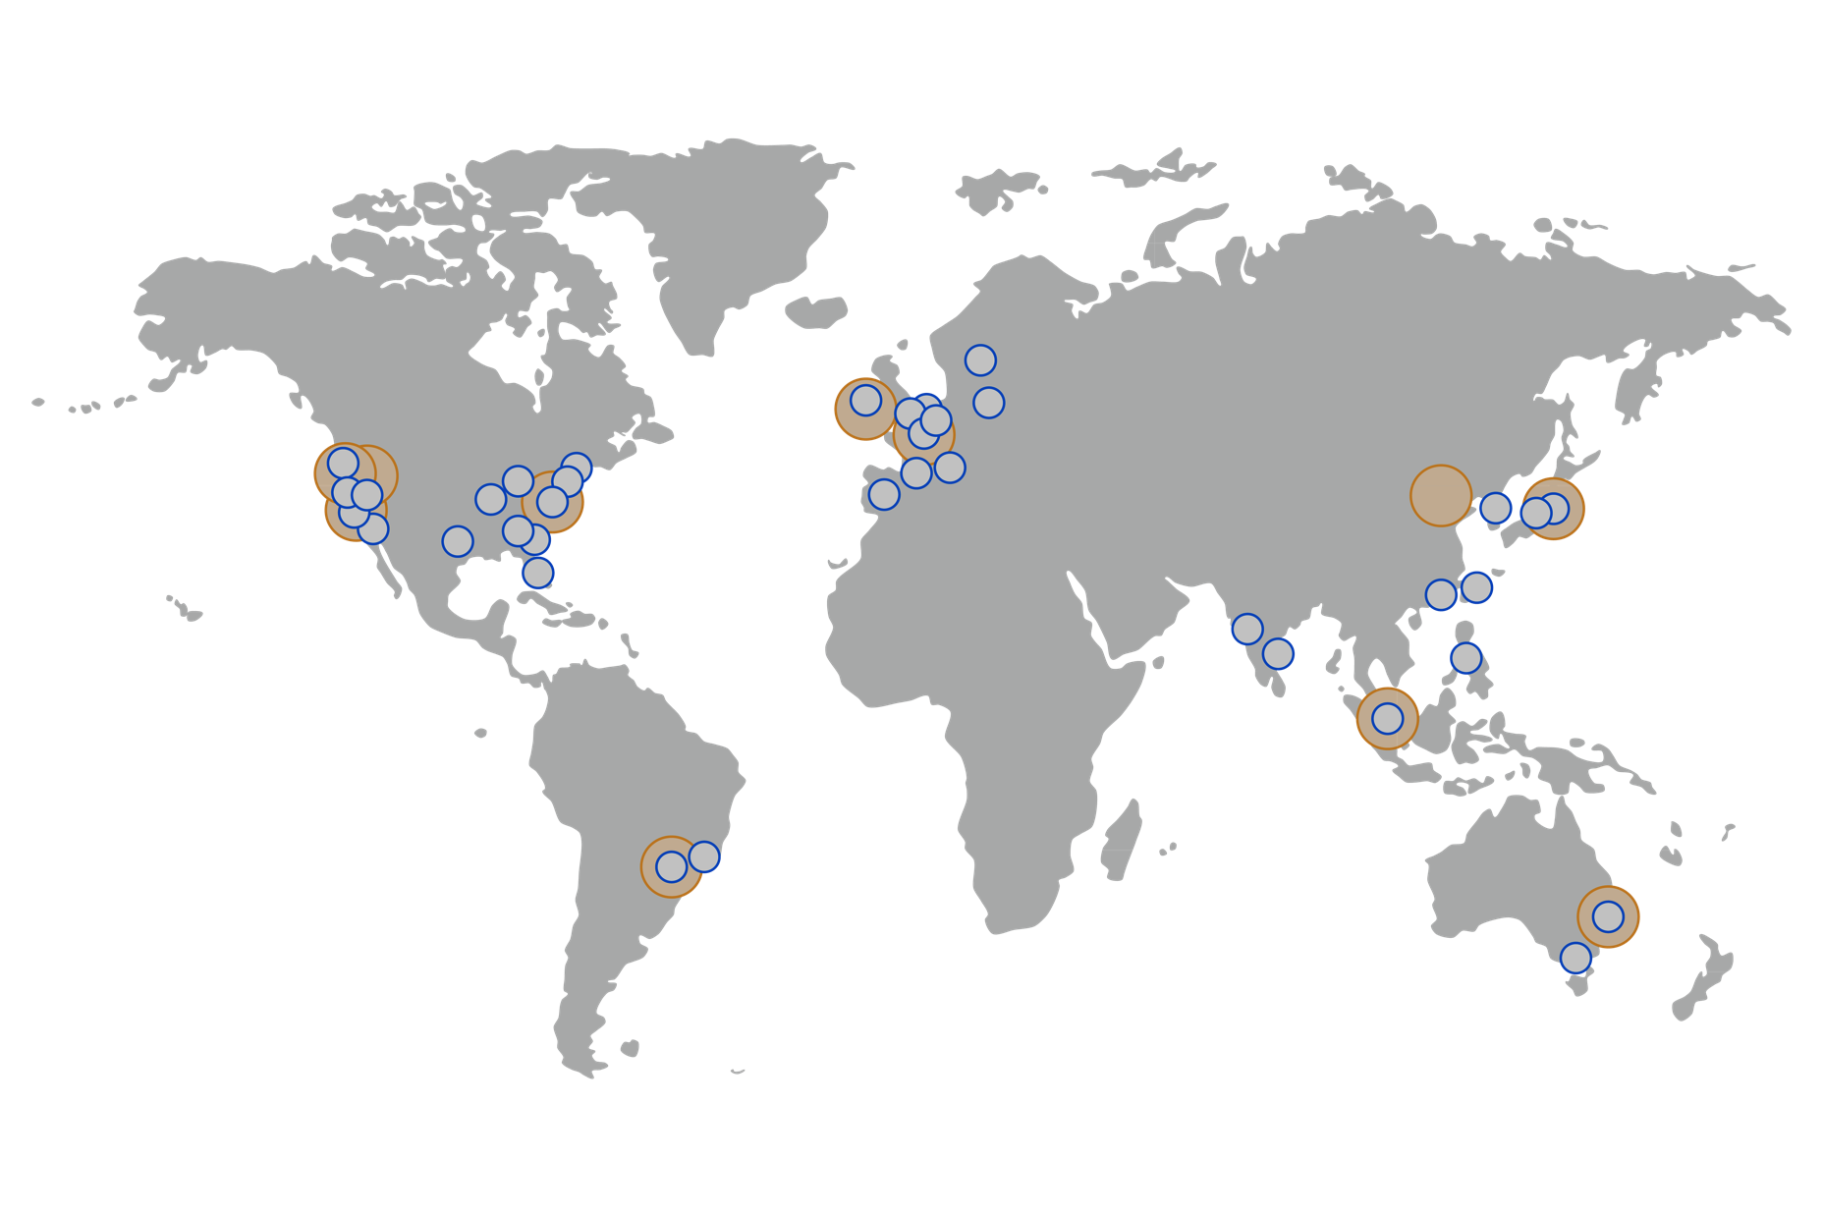
Regions and Edge Locations
12 AWS Regions
53 AWS Edge Locations
Notes:
AWS is steadily expanding the global infrastructure to help customers achieve lower latency and higher throughput, and to ensure that your data resides only in the region you specify. As you and all customers grow their businesses, AWS will continue to provide infrastructure that meets your global requirements.
As of Jan 2015, AWS has 53 edge locations and 12 regions. The GovCloud (US) is an isolated region designed to allow US government agencies and customers to move sensitive workloads into the cloud by addressing their specific regulatory and compliance requirements. Our newest region is Frankfurt, launched in October 2014. AWS Products and Services are available by region so you may not see all regions available for a given service.
You can run applications and workloads from a region to reduce latency to end-users while avoiding the up-front expenses, long-term commitments, and scaling challenges associated with maintaining and operating a global infrastructure.
Edge locations helps lower latency and improves performance for end users.
More details and up-to-date information on global infrastructure can be found on the AWS website: http://aws.amazon.com/about-aws/globalinfrastructure/

Slide 16
AWS Regions and Availability Zones (AZ)
US Regions
Global Regions
US East (VA)
US West (CA)
Asia Pacific (Tokyo)
Asia Pacific (Singapore)
South America (Sao Paulo)
China (Beijing)
AZ - A
AZ - B
AZ - A
AZ - B
AZ - A
AZ - B
AZ - E
AZ - A
AZ - B
AZ - A
AZ - B
AZ - A
AZ - B
AZ - C
AZ - D
AZ - C
AZ - C
Coming Soon
US West (OR)
GovCloud (US)
Asia Pacific (Sydney)
EU (Ireland)
EU (Frankfurt)
AZ - A
AZ - B
AZ - A
AZ - B
AZ - A
AZ - B
AZ - A
AZ - B
AZ - A
AZ - B
AZ - C
AZ - C
Note: Conceptual drawing only. The number of Availability Zones (AZ) may vary.
Notes:
AWS products and services like Amazon Elastic Compute Cloud (Amazon EC2) are offered by region. All regions have at least two Availability Zones (AZ) for redundancy.
Availability Zones are analogous to clusters of datacenters. Where natural disasters or fault lines are a consideration, we isolate them so that they are not easily affected at the same time. There is a latency of less tan 10 milliseconds between Availability Zones. Availability Zones are physically distinct groups of data centers. A region is made of multiple availability zones so as to allow our customers the ability to spread their computing resource across multiple power providers. Where natural disasters are a serious consideration we do our best to isolate AZs from each other. For example, where earthquakes are a problem we would not build two AZs on the same fault line.
More information about AWS global infrastructure can be found online: http://aws.amazon.com/about-aws/global-infrastructure/regional-product-services/
More information about the China Region: https://www.amazonaws.cn/en/

Slide 17

Achieving High Availability Using Multi-AZ
Region
Availability Zone - A
Availability Zone - B
Availability Zone - C
Notes:
AWS highly recommends provisioning your resources across multiple Availability Zones. If you multiple server, you can run them across more than one AZ and get added redundancy. If a single AZ has a problem, all assets in your second AZ will be unaffected.

Slide 18
Shared Security Responsibility—AWS
Customer Data
Platform, Applications, Identity & Access Management
Customer
Operating System, Network & Firewall Configuration
Client-side Data Encryption & Data Integrity Authentication
Server-side Encryption
(File System and/or Data)
Network Traffic Protection
(Encryption/Integrity/Identity)
Foundation Services
Compute
Storage
Database
Network
AWS
AWS Global Infrastructure
Availability Zones
Edge Locations
Regions
Notes:
When we talk about cloud security, we like to start with a discussion of the Shared Security Responsibility Model. While AWS takes care of provisioning and maintaining the underlying cloud infrastructure, you will still need to perform several security configuration tasks to ensure that you stay safe in the cloud. Our responsibility goes from the ground up to the hypervisor. We secure the hardware, software, facilities, and networks that run all of our products and services. Customers are responsible for securely configuring the services they sign up for as well as anything they put on those services.
AWS:
Obtaining industry certifications and independent third party attestations
Publishing information about AWS security and control practices in whitepapers and web site content
Providing certificates, reports, and other documentation directly to AWS customers under NDA (as required).
AWS Security Process: http://d36cz9buwru1tt.cloudfront.net/pdf/AWS_Security_Whitepaper.pdf
The amount of security configuration work you have to do varies, depending on how sensitive your data is and which services you select. For example, AWS services such as EC2 and S3 are completely under your control and require you to perform all of the necessary security configuration and management tasks. In the case of EC2, you’re responsible for management of the guest OS (including updates and security patches), any application software or utilities you install on the instances, as well as the configuration of the AWS-provided firewall (called a security group) on each instance.
When you use any of AWS’s managed services like RDS or RedShift or WorkDocs, you don’t have to worry about launching and maintaining instances or patching the guest OS or applications—AWS handles that for you. For these managed services, basic security configuration tasks like data backups, database replication, and firewall configuration happen automatically.
However, there are certain security features—such as IAM user accounts and credentials, SSL for data transmissions, and user activity logging—that you should configure no matter which AWS service you use
AWS Support provides a highly personalized level of service for customers seeking technical help. More information can be found online: https://aws.amazon.com/premiumsupport/

Slide 19


Physical Security
24/7 trained security guards
Locations in nondescript, undisclosed facilities
Two-factor authentication for ingress
Authorization for datacenter access
Notes:
One of the main security responsibilities of AWS is the physical security of the datacenters that house the AWS cloud infrastructure. Amazon has many years of experience designing, constructing, and operating large-scale datacenters.
The physical security measures that protect these datacenters are some of the most comprehensive in the industry and include: 24/7 trained security guards; locations in nondescript, undisclosed facilities; two-factor authentication for ingress; authorization for data center access only for an approved; specific need and continuous monitoring, logging, and auditing of physical access controls.
Security Center: http://aws.amazon.com/security

Slide 20
Hardware, Software, and Network
Automated change-control process
Bastion servers that record all access attempts
Firewall and other boundary devices
AWS monitoring tools
Notes:
The hardware and software that supports AWS’ cloud services has been architected to be not only highly available and redundant, but also extremely secure. All changes to AWS hardware and software are managed through a centralized, automated change control process, and all access to hardware or software must be authorized.
Privileged access to software and systems requires SSH logon and is allowed only through bastion servers that record all access attempts. AWS network devices, including firewall and other boundary devices, monitor and control communications at the external boundary of the network and at key internal boundaries.
AWS monitoring tools are designed to detect unusual or unauthorized activities and conditions at ingress and egress communication points. These tools monitor server and network usage, port scanning activities, application usage, and unauthorized intrusion attempts. AWS security monitoring tools help identify several types of denial of service (DoS) attacks, including distributed, flooding, and software/logic attacks.

Slide 21
SSL Endpoints
SSL Endpoints
Security Groups
IAM
VPC
Secure Transmission
Establish secure communication sessions (HTTPS) using SSL
Instance Firewalls
Configure firewall rules for instances using Security Groups
User Accounts
Create individual IAM accounts so that each of your users has their own AWS security credentials
Subnet Control
In your Virtual Private Cloud, create low-level networking constraints for resource access, such as public and private subnets, internet gateways, and NATs
Notes:
AWS provides customer access points, also called API endpoints, that allow HTTPS access so that you can establish secure communication sessions with your AWS services including SSL. SSL encrypts the transmission, protecting each request or the response from being viewed in transit.

Slide 22
Security Groups
SSL Endpoints
Security Groups
IAM
VPC
Secure Transmission
Establish secure communication sessions (HTTPS) using SSL
Instance Firewalls
Configure firewall rules for instances using Security Groups
User Accounts
Create individual IAM accounts so that each of your users has their own AWS security credentials
Subnet Control
In your Virtual Private Cloud, create low-level networking constraints for resource access, such as public and private subnets, internet gateways, and NATs
Notes:
AWS also provides security groups, which act like built-in firewalls for your virtual servers. You can control how accessible your instances are by configuring security group rules-from totally public to completely private, or somewhere in between. And when your instances reside within a Virtual Private Cloud (VPC) subnet, you can control egress as well as ingress.

Slide 23








AWS Multi-tier Security Groups
Web Tier
EC2
Application Tier
HTTP
EC2
Ports 80 and 443 only open to the Internet
Database Tier
SSH/RDP
Bastion
EC2
Engineering staff have SSH/RDP access to Bastion Host
DB-sync
DB-sync can be established with a database server running “on-premises”
All other internet ports blocked by default
Notes:
You can set up security group rules for your EC2 instances to create a traditional multi-tiered web architecture:
The web tier security group can accept traffic on port 80/443 from anywhere on the Internet if you select source 0.0.0.0/0. Alternatively, it might make more sense to only accept traffic from a load balancer so that individual clients cannot overload a single server and the load balancer can perform its job.
Similarly, the app tier can only accept traffic from the web tier, and the DB tier can only accept traffic from the app tier.
Lastly, we have also added a set of rules to allow remote administration over SSH port 22. We have restricted remote access by funneling all traffic through the app tier and allowing access only from a specific IP. After you use SSH to access an app tier server, you can then connect to machines on the web and DB security groups.

Slide 24
AWS Identity and Access Management (IAM)
SSL Endpoints
Security Groups
IAM
VPC
Secure Transmission
Establish secure communication sessions (HTTPS) using SSL
Instance Firewalls
Configure firewall rules for instances using Security Groups
User Accounts
Create individual IAM accounts so that each of your users has their own AWS security credentials
Subnet Control
In your Virtual Private Cloud, create low-level networking constraints for resource access, such as public and private subnets, internet gateways, and NATs
Notes:
AWS IAM is a centralized access management tool for users and applications that need access to your AWS resources. IAM allows you to create multiple user accounts within your AWS Account, providing each user with their own unique security credentials and eliminating the need to share passwords or secret keys. It enables you to implement security best practices, such as least privilege, by only granting permission to access the AWS services and resources required for the users to perform their jobs.
AWS Identity and Access Management (IAM), enables you to securely control access to AWS services and resources for your users. Using IAM, you can create and manage AWS users and groups and use permissions to allow and deny them access to AWS resources.

Slide 25

Account Control with IAM
AWS Identity and Access Management (IAM):
Securely control access to AWS services and resources
Create and manage AWS users and groups
AWS Master accounts should not be used for production systems!!
You should be using IAM user accounts.
Notes:
AWS IAM is a centralized access management tool for users and applications that need access to your AWS resources. IAM allows you to create multiple user accounts within your AWS Account, providing each user with their own unique security credentials and eliminating the need to share passwords or secret keys. It enables you to implement security best practices, such as least privilege, by only granting permission to access the AWS services and resources required for the users to perform their jobs.
AWS Identity and Access Management (IAM), enables you to securely control access to AWS services and resources for your users. Using IAM, you can create and manage AWS users and groups and use permissions to allow and deny them access to AWS resources.

Slide 26
Amazon Virtual Private Cloud (VPC)
SSL Endpoints
Security Groups
IAM
VPC
Secure Transmission
Establish secure communication sessions (HTTPS) using SSL
Instance Firewalls
Configure firewall rules for instances using Security Groups
User Accounts
Create individual IAM accounts so that each of your users has their own AWS security credentials
Subnet Control
In your Virtual Private Cloud, create low-level networking constraints for resource access, such as public and private subnets, internet gateways, and NATs
Notes:
The Amazon Virtual Private Cloud (VPC) service allows you to add another layer of network security to your instances by creating private subnets and even adding an IPsec VPN tunnel between your home network and your AWS VPC. VPC allows you to define your own network topology, including definitions for subnets, network access control lists, Internet gateways, routing tables, and virtual private gateways. The subnets that you create can be defined as either private or public.
Learn more about Amazon VPC: http://aws.amazon.com/vpc/

Slide 27
EC2 Feature Consideration
Amazon Elastic Compute Cloud (Amazon EC2) is a web service that provides resizable compute capacity in the cloud.
Amazon EC2 provides a number of powerful features for building scalable, failure resilient, enterprise class applications
Elastic Web-Scale Computing
Completely Controlled
Flexible Cloud Hosting Services
Designed for use with other Amazon Web Services
Reliable
Secure
Inexpensive
Multi Locations
Elastic IP address
Amazon Virtual Private Cloud
Auto Scaling
Amazon Cloud Watch
Enhanced Networking
EC2 video link https://www.youtube.com/watch?v=wNr7YqjjzOY
Notes:
Features
Amazon EC2 provides a number of powerful features for building scalable, failure resilient, enterprise class applications.
Amazon Elastic Block Store
Amazon Elastic Block Store (EBS) offers persistent storage for Amazon EC2 instances. Amazon EBS volumes are network-attached, and persist independently from the life of an instance. Amazon EBS volumes are highly available, highly reliable volumes that can be leveraged as an Amazon EC2 instance’s boot partition or attached to a running Amazon EC2 instance as a standard block device. When used as a boot partition, Amazon EC2 instances can be stopped and subsequently restarted, enabling you to only pay for the storage resources used while maintaining your instance’s state. Amazon EBS volumes offer greatly improved durability over local Amazon EC2 instance stores, as Amazon EBS volumes are automatically replicated on the backend (in a single Availability Zone). For those wanting even more durability, Amazon EBS provides the ability to create point-in-time consistent snapshots of your volumes that are then stored in Amazon S3, and automatically replicated across multiple Availability Zones. These snapshots can be used as the starting point for new Amazon EBS volumes, and can protect your data for long term durability. You can also easily share these snapshots with co-workers and other AWS developers. Amazon EBS provides three volume types to best meet the needs of your workloads: General Purpose (SSD), Provisioned IOPS (SSD), and Magnetic. General Purpose (SSD) is the new, SSD-backed, general purpose EBS volume type that we recommend as the default choice for customers. General Purpose (SSD) volumes are suitable for a broad range of workloads, including small to medium sized databases, development and test environments, and boot volumes. Provisioned IOPS (SSD) volumes offer storage with consistent and low-latency performance, and are designed for I/O intensive applications such as large relational or NoSQL databases. Magnetic volumes provide the lowest cost per gigabyte of all EBS volume types. Magnetic volumes are ideal for workloads where data is accessed infrequently, and applications where the lowest storage cost is important. SeeAmazon Elastic Block Store for more details.
EBS-Optimized Instances
For an additional, low, hourly fee, customers can launch selected Amazon EC2 instances types as EBS-optimized instances. For C4, M4, and D2 instances, this feature is enabled by default at no additional cost. EBS-optimized instances enable EC2 instances to fully use the IOPS provisioned on an EBS volume. EBS-optimized instances deliver dedicated throughput between Amazon EC2 and Amazon EBS, with options between 500 and 4,000 Megabits per second (Mbps) depending on the instance type used. The dedicated throughput minimizes contention between Amazon EBS I/O and other traffic from your EC2 instance, providing the best performance for your EBS volumes. EBS-optimized instances are designed for use with both Standard and Provisioned IOPS Amazon EBS volumes. When attached to EBS-optimized instances, Provisioned IOPS volumes can achieve single digit millisecond latencies and are designed to deliver within 10% of the provisioned IOPS performance 99.9% of the time. We recommend using Provisioned IOPS volumes with EBS-optimized instances or instances that support cluster networking for applications with high storage I/O requirements. For more information about the instance types that can be launched as EBS-Optimized instances, see Amazon EC2 Instance Types.
Multiple Locations
Amazon EC2 provides the ability to place instances in multiple locations. Amazon EC2 locations are composed of Regions and Availability Zones. Availability Zones are distinct locations that are engineered to be insulated from failures in other Availability Zones and provide inexpensive, low latency network connectivity to other Availability Zones in the same Region. By launching instances in separate Availability Zones, you can protect your applications from failure of a single location. Regions consist of one or more Availability Zones, are geographically dispersed, and will be in separate geographic areas or countries. TheAmazon EC2 Service Level Agreement commitment is 99.95% availability for each Amazon EC2 Region. Please refer to Regional Products and Services for more details of our product and service availability by region.
Elastic IP Addresses
Elastic IP addresses are static IP addresses designed for dynamic cloud computing. An Elastic IP address is associated with your account not a particular instance, and you control that address until you choose to explicitly release it. Unlike traditional static IP addresses, however, Elastic IP addresses allow you to mask instance or Availability Zone failures by programmatically remapping your public IP addresses to any instance in your account. Rather than waiting on a data technician to reconfigure or replace your host, or waiting for DNS to propagate to all of your customers, Amazon EC2 enables you to engineer around problems with your instance or software by quickly remapping your Elastic IP address to a replacement instance. In addition, you can optionally configure the reverse DNS record of any of your Elastic IP addresses by filling out this form.
Amazon Virtual Private Cloud
Amazon Virtual Private Cloud (Amazon VPC) lets you provision a logically isolated section of the Amazon Web Services (AWS) Cloud where you can launch AWS resources in a virtual network that you define. You have complete control over your virtual networking environment, including selection of your own IP address range, creation of subnets, and configuration of route tables and network gateways. You can also create a Hardware Virtual Private Network (VPN) connection between your corporate datacenter and your VPC and leverage the AWS cloud as an extension of your corporate datacenter. See Amazon Virtual Private Cloud for more details.
Amazon CloudWatch
Amazon CloudWatch is a web service that provides monitoring for AWS cloud resources and applications, starting with Amazon EC2. It provides you with visibility into resource utilization, operational performance, and overall demand patterns—including metrics such as CPU utilization, disk reads and writes, and network traffic. You can get statistics, view graphs, and set alarms for your metric data. To use Amazon CloudWatch, simply select the Amazon EC2 instances that you’d like to monitor. You can also supply your own business or application metric data. Amazon CloudWatch will begin aggregating and storing monitoring data that can be accessed using web service APIs or Command Line Tools. See Amazon CloudWatch for more details.
Auto Scaling
Auto Scaling allows you to automatically scale your Amazon EC2 capacity up or down according to conditions you define. With Auto Scaling, you can ensure that the number of Amazon EC2 instances you’re using scales up seamlessly during demand spikes to maintain performance, and scales down automatically during demand lulls to minimize costs. Auto Scaling is particularly well suited for applications that experience hourly, daily, or weekly variability in usage. Auto Scaling is enabled by Amazon CloudWatch and available at no additional charge beyond Amazon CloudWatch fees. See Auto Scaling for more details.
Elastic Load Balancing
Elastic Load Balancing automatically distributes incoming application traffic across multiple Amazon EC2 instances. It enables you to achieve even greater fault tolerance in your applications, seamlessly providing the amount of load balancing capacity needed in response to incoming application traffic. Elastic Load Balancing detects unhealthy instances within a pool and automatically reroutes traffic to healthy instances until the unhealthy instances have been restored. You can enable Elastic Load Balancing within a single Availability Zone or across multiple zones for even more consistent application performance. Amazon CloudWatch can be used to capture a specific Elastic Load Balancer’s operational metrics, such as request count and request latency, at no additional cost beyond Elastic Load Balancing fees. See Elastic Load Balancing for more details.
High Performance Computing (HPC) Clusters
Customers with complex computational workloads such as tightly coupled parallel processes, or with applications sensitive to network performance, can achieve the same high compute and network performance provided by custom-built infrastructure while benefiting from the elasticity, flexibility and cost advantages of Amazon EC2. Cluster Compute, Cluster GPU, and High Memory Cluster instances have been specifically engineered to provide high-performance network capability and can be programmatically launched into clusters – allowing applications to get the low-latency network performance required for tightly coupled, node-to-node communication. Cluster instances also provide significantly increased throughput making them well suited for customer applications that need to perform network-intensive operations. Learn more about how Amazon EC2 and other AWS services can be used for HPC Applications.
GPU Instances
Customers requiring high parallel performance capability will benefit from GPU instances, which provide access to NVIDIA GPUs each with up to 1,536 CUDA cores and 4GB of video memory. With the latest driver releases, these GPUs provide support for OpenGL, DirectX, CUDA, OpenCL, and the GRID SDK. GPU instances are ideally suited for 3D graphics applications, including game streaming, and compute workloads, including computational chemistry, financial modeling, and engineering design.
High I/O Instances
Customers requiring very high, low latency, random I/O access to their data can benefit from High I/O instances. High I/O instances are an Amazon EC2 instance type that can provide customers with random I/O rates over 100,000 IOPS. High I/O instances are backed by Solid State Disk (SSD) technology and are ideally suited for customers running very high performance NoSQL and relational databases. See Amazon EC2 Instance Types to find out more about High I/O instances.
Dense Storage Instances
Customers requiring very high storage density per instance, and high sequential I/O for data-intensive applications like Massively Parallel Processing (MPP) data warehouse, MapReduce and Hadoop distributed computing, and log and data processing can benefit from Dense Storage instances. Dense Storage instances are an Amazon EC2 instance type that can provide customers with sequential I/O throughout of up to 3.9 GB/s and provide customers with up to 48 TB of instance storage across 24 hard disk drives. SeeAmazon EC2 Instance Types to find out more about Dense Storage instances.
VM Import/Export
VM Import/Export enables you to easily import virtual machine images from your existing environment to Amazon EC2 instances and export them back at any time. By importing virtual machines as ready to use EC2 instances, you can leverage your existing investments in virtual machines that meet your IT security, configuration management, and compliance requirements. You can export your previously imported EC2 instances back to your on-premise environment at any time. This offering is available at no additional charge beyond standard usage charges for Amazon EC2 and Amazon S3. Learn more about VM Import/Export.
Run Command
Run Command is a feature that enables you to securely manage the configuration of your Amazon EC2 Windows instances. Using Run Command provides a simple way of automating common administrative tasks like executing scripts, running PowerShell commands, installing software or patches, and more. Run Command allows you to perform these commands across multiple instances and provides visibility into the results, making it easy to manage configuration change across fleets of instances. Run Command is available at no addition charge beyond the standard usage charges for Amazon EC2, Amazon S3, and other AWS services you may use. Learn more about Run Command.
AWS Marketplace
AWS Marketplace is an online store that helps you find, buy and quickly deploy software that runs on AWS. You can use AWS Marketplace’s 1-Click deployment to quickly launch pre-configured software and be charged for what you use, by the hour or month. AWS handles billing and payments, and software charges appear on your AWS bill. Learn more about AWS Marketplace.
Enhanced Networking
Enhanced Networking enables you to get significantly higher packet per second (PPS) performance, lower network jitter and lower latencies. This feature uses a new network virtualization stack that provides higher I/O performance and lower CPU utilization compared to traditional implementations. In order to take advantage of Enhanced Networking, you should launch an HVM AMI in VPC, and install the appropriate driver. Enhanced Networking is currently supported in R3, C3, C4, M4, D2, and I2 instances. For instructions on how to enable Enhanced Networking on EC2 instances, see the Enhanced Networking on Linux andEnhanced Networking on Windows tutorials. To learn more about this feature, check out the Enhanced Networking FAQ section.

Slide 28
EC2 Elastic Properties
Elastic – Amazon EC2 enables you to increase or decrease capacity within minutes, not hours or days.
You can commission one, hundreds or even thousands of server instances simultaneously.
controlled with web service APIs, application can automatically scale itself up and down depending on its needs.
Elastic Block Store vs. local Disk (not backup)
Elastic IP Addresses vs. Static IP Addresses
Interesting charging scheme; you are charged when not using it
programmatically remapping your public IP addresses to any instance in your account

Slide 29
EC2 Instance Type
Instance Type | Instance Name | Application Suitability
General Purpose | T2,M3, M4 | Development environments, build servers, code repositories, low-traffic websites and web applications, micro services, early product experiments, small databases
Compute Optimized | C3, C4 | High performance front-end fleets, web-servers, batch processing, distributed analytics, high performance science and engineering applications, ad serving, MMO gaming, and video-encoding
Memory Optimized | R3 | We recommend memory-optimized instances for high performance databases, distributed memory caches, in-memory analytics, genome assembly and analysis, larger deployments of SAP, Microsoft SharePoint, and other enterprise applications.
GPU | G2 | 3D application streaming, machine learning, video encoding, and other server-side graphics or GPU compute workload
Storage Optimized | I2 | NOSQL Databases like Cassandra and MongoDB, scale out transactional databases, data warehousing, Hadoop, and cluster file systems.
Dense Storage | D2 | Massively Parallel Processing (MPP) data warehousing, MapReduce and Hadoop distributed computing, distributed file systems, network file systems, log or data-processing applications
Notes:
Amazon EC2 provides a wide selection of instance types optimized to fit different use cases. Instance types comprise varying combinations of CPU, memory, storage, and networking capacity and give you the flexibility to choose the appropriate mix of resources for your applications. Each instance type includes one or more instance sizes, allowing you to scale your resources to the requirements of your target workload.
General Purpose
T2
T2 instances are Burstable Performance Instancesthat provide a baseline level of CPU performance with the ability to burst above the baseline. The baseline performance and ability to burst are governed by CPU Credits. Each T2 instance receives CPU Credits continuously at a set rate depending on the instance size. T2 instances accrue CPU Credits when they are idle, and use CPU credits when they are active. T2 instances are a good choice for workloads that don’t use the full CPU often or consistently, but occasionally need to burst (e.g. web servers, developer environments and small databases). For more information seeBurstable Performance Instances.
Features:
High Frequency Intel Xeon Processors with Turbo up to 3.3GHz
Burstable CPU, governed by CPU Credits, and consistent baseline performance
Lowest-cost general purpose instance type, and Free Tier eligible (t2.micro only)
Balance of compute, memory, and network resources
ModelvCPUCPU Credits / hour Mem (GiB) Storage t2.nano130.5EBS-Onlyt2.micro161EBS-Only t2.small1122EBS-Only t2.medium2244EBS-Only t2.large2368EBS-Only
Use Cases
Development environments, build servers, code repositories, low-traffic websites and web applications, micro services, early product experiments, small databases.
M4
M4 instances are the latest generation of General Purpose Instances. This family provides a balance of compute, memory, and network resources, and it is a good choice for many applications.
Features:
2.4 GHz Intel Xeon® E5-2676 v3 (Haswell) processors
EBS-optimized by default at no additional cost
Support for Enhanced Networking
Balance of compute, memory, and network resources
ModelvCPUMem (GiB)SSD Storage (GB)Dedicated EBS Throughput (Mbps)m4.large2 8EBS-only 450
m4.xlarge4 16EBS-only 750
m4.2xlarge8 32 EBS-only1,000
m4.4xlarge16 64 EBS-only2,000
m4.10xlarge 40 160 EBS-only4,000
M3
This family includes the M3 instance types and provides a balance of compute, memory, and network resources, and it is a good choice for many applications.
Features:
High Frequency Intel Xeon E5-2670 v2 (Ivy Bridge) Processors*
SSD-based instance storage for fast I/O performance
Balance of compute, memory, and network resources
ModelvCPUMem (GiB)SSD Storage (GB)m3.medium13.751 x 4 m3.large27.51 x 32m3.xlarge4152 x 40m3.2xlarge8302 x 80
Use Cases
Small and mid-size databases, data processing tasks that require additional memory, caching fleets, and for running backend servers for SAP, Microsoft SharePoint, cluster computing, and other enterprise applications.
*M3 instances may also launch as an Intel Xeon E5-2670 (Sandy Bridge) Processor running at 2.6 GHz.
Compute Optimized
C4
C4 instances are the latest generation of Compute-optimized instances, featuring the highest performing processors and the lowest price/compute performance in EC2.
Features:
High frequency Intel Xeon E5-2666 v3 (Haswell) processors optimized specifically for EC2
EBS-optimized by default and at no additional cost
Ability to control processor C-state and P-state configuration on the c4.8xlarge instance type
Support for Enhanced Networking and Clustering
ModelvCPUMem (GiB)Storage Dedicated EBS Throughput (Mbps) c4.large23.75EBS-Only500 c4.xlarge47.5EBS-Only750 c4.2xlarge815EBS-Only1,000 c4.4xlarge1630EBS-Only2,000 c4.8xlarge3660EBS-Only4,000
C3
Features:
High Frequency Intel Xeon E5-2680 v2 (Ivy Bridge) Processors
Support for Enhanced Networking
Support for clustering
SSD-backed instance storage
ModelvCPUMem (GiB)SSD Storage (GB)c3.large23.752 x 16c3.xlarge47.52 x 40c3.2xlarge8152 x 80c3.4xlarge16302 x 160c3.8xlarge32602 x 320
Use Cases
High performance front-end fleets, web-servers, batch processing, distributed analytics, high performance science and engineering applications, ad serving, MMO gaming, and video-encoding.
Memory Optimized
R3
R3 instances are optimized for memory-intensive applications and have the lowest cost per GiB of RAM among Amazon EC2 instance types.
Features:
High Frequency Intel Xeon E5-2670 v2 (Ivy Bridge) Processors
Lowest price point per GiB of RAM
SSD Storage
Support for Enhanced Networking
ModelvCPUMem (GiB)SSD Storage (GB)r3.large215.251 x 32 r3.xlarge430.51 x 80 r3.2xlarge8611 x 160 r3.4xlarge161221 x 320 r3.8xlarge 32 244 2 x 320
Use Cases
We recommend memory-optimized instances for high performance databases, distributed memory caches, in-memory analytics, genome assembly and analysis, larger deployments of SAP, Microsoft SharePoint, and other enterprise applications.
GPU
G2
This family includes G2 instances intended for graphics and general purpose GPU compute applications.
Features:
High Frequency Intel Xeon E5-2670 (Sandy Bridge) Processors
High-performance NVIDIA GPUs, each with 1,536 CUDA cores and 4GB of video memory
Each GPU features an on-board hardware video encoder designed to support up to eight real-time HD video streams (720p@30fps) or up to four real-time full HD video streams (1080p@30fps)
Support for low-latency frame capture and encoding for either the full operating system or select render targets, enabling high-quality interactive streaming experiences
ModelGPUsvCPUMem (GiB)SSD Storage (GB)g2.2xlarge18151 x 60g2.8xlarge432602 x 120
Use Cases
3D application streaming, machine learning, video encoding, and other server-side graphics or GPU compute workloads.
Storage Optimized
I2 – High I/O Instances
This family includes the High Storage Instances that provide very fast SSD-backed instance storage optimized for very high random I/O performance, and provide high IOPS at a low cost.
Features:
High Frequency Intel Xeon E5-2670 v2 (Ivy Bridge) Processors
SSD Storage
Support for TRIM
Support for Enhanced Networking
High Random I/O performance
ModelvCPUMem (GiB)Storage (GB)i2.xlarge430.51 x 800 SSDi2.2xlarge8612 x 800 SSDi2.4xlarge161224 x 800 SSDi2.8xlarge322448 x 800 SSD
Use Cases
NoSQL databases like Cassandra and MongoDB, scale out transactional databases, data warehousing, Hadoop, and cluster file systems.
D2 – Dense-storage Instances
D2 instances feature up to 48 TB of HDD-based local storage, deliver high disk throughput, and offer the lowest price per disk throughput performance on Amazon EC2.
Features:
High-frequency Intel Xeon E5-2676v3 (Haswell) processors
HDD storage
Consistent high performance at launch time
High disk throughput
Support for Amazon EC2 Enhanced Networking
ModelvCPUMem (GiB)Storage (GB)d2.xlarge430.53 x 2000 HDD d2.2xlarge8616 x 2000 HDDd2.4xlarge1612212 x 2000 HDDd2.8xlarge3624424 x 2000 HDD
Use Cases
Massively Parallel Processing (MPP) data warehousing, MapReduce and Hadoop distributed computing, distributed file systems, network file systems, log or data-processing applications
Instance Types Matrix
Instance TypevCPUMemory (GiB) Storage (GB)Networking Performance Physical ProcessorClock Speed (GHz)Intel AVX†Intel AVX2†Intel TurboEBS OPT Enhanced Networking†t2.nano10.5EBS OnlyLowIntel Xeon familyup to 3.3Yes-Yes--t2.micro11EBS OnlyLow to ModerateIntel Xeon familyUp to 3.3 Yes-Yes--t2.small1 2 EBS Only Low to Moderate Intel Xeon family Up to 3.3Yes - Yes - - t2.medium24EBS OnlyLow to ModerateIntel Xeon family Up to 3.3Yes - Yes - - t2.large28 EBS OnlyLow to ModerateIntel Xeon family Up to 3.0 Yes - Yes - - m4.large28EBS Only ModerateIntel Xeon E5-2676 v32.4YesYesYesYesYesm4.xlarge416EBS OnlyHighIntel Xeon E5-2676 v32.4YesYesYesYesYesm4.2xlarge832EBS OnlyHighIntel Xeon E5-2676 v32.4YesYesYesYesYesm4.4xlarge1664EBS OnlyHighIntel Xeon E5-2676 v32.4YesYesYesYesYesm4.10xlarge40160EBS Only10 Gigabit Intel Xeon E5-2676 v32.4YesYesYesYesYesm3.medium13.751 x 4 SSDModerateIntel Xeon E5-2670 v2*2.5Yes-Yes--m3.large27.51 x 32 SSDModerateIntel Xeon E5-2670 v2*2.5Yes-Yes--m3.xlarge4152 x 40 SSDHighIntel Xeon E5-2670 v2*2.5Yes-YesYes-m3.2xlarge8302 x 80 SSDHighIntel Xeon E5-2670 v2*2.5Yes-YesYes-c4.large 2 3.75 EBS Only Moderate Intel Xeon E5-2666 v3 2.9 Yes Yes Yes Yes Yes c4.xlarge 4 7.5 EBS OnlyHigh Intel Xeon E5-2666 v32.9 YesYes YesYesYesc4.2xlarge 8 15 EBS OnlyHigh Intel Xeon E5-2666 v32.9 YesYes YesYesYesc4.4xlarge 16 30 EBS OnlyHigh Intel Xeon E5-2666 v32.9 YesYes YesYesYesc4.8xlarge 36 60 EBS Only10 Gigabit Intel Xeon E5-2666 v32.9 YesYes YesYesYesc3.large23.752 x 16 SSDModerateIntel Xeon E5-2680 v22.8Yes-Yes-Yesc3.xlarge47.52 x 40 SSDModerateIntel Xeon E5-2680 v22.8Yes-YesYesYesc3.2xlarge8152 x 80 SSDHighIntel Xeon E5-2680 v22.8Yes-YesYesYesc3.4xlarge16302 x 160 SSDHighIntel Xeon E5-2680 v22.8Yes-YesYesYesc3.8xlarge32602 x 320 SSD10 GigabitIntel Xeon E5-2680 v22.8Yes-Yes-Yesg2.2xlarge8151 x 60 SSDHighIntel Xeon E5-2670 2.6Yes -YesYes-g2.8xlarge32602 x 120 SSD10 GigabitIntel Xeon E5-26702.6Yes-Yes -- r3.large215.251 x 32 SSDModerateIntel Xeon E5-2670 v22.5Yes-Yes-Yesr3.xlarge430.51 x 80 SSDModerateIntel Xeon E5-2670 v22.5 Yes - Yes YesYesr3.2xlarge8611 x 160 SSDHighIntel Xeon E5-2670 v22.5 Yes - Yes YesYesr3.4xlarge161221 x 320 SSDHighIntel Xeon E5-2670 v22.5 Yes - Yes YesYesr3.8xlarge322442 x 320 SSD10 GigabitIntel Xeon E5-2670 v22.5 Yes - Yes -Yesi2.xlarge430.51 x 800 SSDModerateIntel Xeon E5-2670 v22.5Yes-YesYesYesi2.2xlarge8612 x 800 SSDHighIntel Xeon E5-2670 v22.5Yes-YesYesYesi2.4xlarge161224 x 800 SSDHighIntel Xeon E5-2670 v22.5Yes-YesYesYesi2.8xlarge322448 x 800 SSD10 GigabitIntel Xeon E5-2670 v22.5Yes-Yes-Yesd2.xlarge430.53 x 2000ModerateIntel Xeon E5-2676 v32.4YesYesYesYesYesd2.2xlarge8616 x 2000HighIntel Xeon E5-2676 v32.4YesYesYesYesYesd2.4xlarge1612212 x 2000HighIntel Xeon E5-2676 v32.4YesYesYesYesYesd2.8xlarge3624424 x 200010 GigabitIntel Xeon E5-2676 v32.4YesYesYesYesYes
Each vCPU is a hyperthread of an Intel Xeon core for M4, M3, C4, C3, R3, HS1, G2, I2, and D2.
*M3 instances may also launch as an Intel Xeon E5-2670 (Sandy Bridge) Processor running at 2.6 GHz.
† AVX, AVX2, and Enhanced Networking are only available on instances launched with HVM AMIs.
Looking for T1, M1, C1, CC2, M2, CR1, CG1, HS1, or HI1 Instances? See the Previous Generation Instancespage.
AWS MOBILE SERVICES
Easily build or enhance your app with AWS Mobile Services

Slide 30
AWS EC2 Pricing Model
Free Usage Tier
On-Demand Instances
Start and stop instances whenever you like, costs are rounded up to the nearest hour. (Worst price)
Reserved Instances
Pay up front for one/three years in advance. (Best price)
Unused instances can be sold on a secondary market.
Spot Instances
Specify the price you are willing to pay, and instances get started and stopped without any warning as the marked changes.

Slide 31
AWS EC2 Free UsageTier
750 hours of EC2 running Linux, RHEL, or SLES t2.micro instance usage
750 hours of EC2 running Microsoft Windows Server t2.micro instance usage
750 hours of Elastic Load Balancing plus 15 GB data processing
30 GB of Amazon Elastic Block Storage in any combination of General Purpose (SSD) or Magnetic, plus 2 million I/Os (with Magnetic) and 1 GB of snapshot storage
15 GB of bandwidth out aggregated across all AWS services
1 GB of Regional Data Transfer

Slide 32
Storage
Instance –store : disappears with the instance (transient)
Block storage: SAN-like, persists across time
S3 is Object storage independent of an instance
Glacier for archival purposes store it now and retrieve it at a later date
Amazon: SimpleDB: Relational database better than MySQL or Oracle for reliability.

Slide 33
Elastic Block Storage (EBS)
An EBS volume is a virtual disk of a fixed size with a block read/write interface. It can be mounted as a file system on a running EC2 instance where it can be updated incrementally. Unlike an instance store, an EBS volume is persistent.
(Compare to an S3 object, which is essentially a file that must be accessed in its entirety.)
Amazon EBS is particularly well-suited for use as the primary storage for a database or file system, or for any applications that require access to raw block-level storage
Fundamental operations:
CREATE a new volume (1GB-1TB)
COPY a volume from an existing EBS volume or S3 object.
MOUNT on one instance at a time.
SNAPSHOT current state to an S3 object.
Notes:
Amazon Elastic Block Store (Amazon EBS) volumes provide durable block-level storage for use with Amazon EC2 instances (virtual machines). Amazon EBS volumes are off-instance, network-attached storage (NAS) that persists independently from the running life of a single Amazon EC2 instance. After an Amazon EBS volume is attached to an instance, you can use it like a physical hard drive, typically by formatting it with the file system of your choice and using the file I/O interface provided by the instance operating system. You can use an Amazon EBS volume to boot an Amazon EC2 instance (Amazon EBS-root AMIs only), and you can attach multiple Amazon EBS volumes to a single Amazon EC2 instance. Note, however, that any single Amazon EBS volume may be attached to only one Amazon EC2 instance at any point in time.

Slide 34
Simple Storage Service (S3)
Simple Storage service is a storage for internet
The number of objects you can store in S3 is unlimited
A bucket is a container for objects and describes location, logging, accounting, and access control. A bucket can hold any number of objects, which are files of up to 5TB. A bucket has a name that must be globally unique.
Fundamental operations corresponding to HTTP actions:
http://bucket.s3.amazonaws.com/object
POST a new object or update an existing object.
GET an existing object from a bucket.
DELETE an object from the bucket
LIST keys present in a bucket, with a filter.
A bucket has a flat directory structure (despite the appearance given by the interactive web interface.)
Amazon S3 works well for fast growing websites hosting data intensive, user-generated content, such as video and photo sharing sites.
No set-up fee, No monthly minimum
Video link https://www.youtube.com/watch?v=1qrjFb0ZTm8
Notes:
Amazon Simple Storage Service (Amazon S3) is storage for the Internet. It’s a simple storage service that offers software developers a highly-scalable, reliable, and low-latency data storage infrastructure at very low costs. Amazon S3 provides a simple web services interface that can be used to store and retrieve any amount of data, at any time, from within Amazon Elastic Compute Cloud (Amazon EC2) or from anywhere on the web. You can write, read, and delete objects containing from 1 byte to 5 terabytes of data each. The number of objects you can store in an Amazon S3 bucket is virtually unlimited. Amazon S3 is also highly secure, supporting encryption at rest, and providing multiple mechanisms to provide fine-grained control of access to Amazon S3 resources. Amazon S3 is also highly scalable, allowing concurrent read or write access to Amazon S3 data by many separate clients or application threads. Finally, Amazon S3 provides data lifecycle management capabilities, allowing users to define rules to automatically archive Amazon S3 data to Amazon Glacier, or to delete data at end of life.
Amazon S3 stores data as objects within buckets. An object consists of a file and optionally any metadata that describes that file.
To store an object in Amazon S3, you upload the file you want to store to a bucket. When you upload a file, you can set permissions on the object as well as any metadata.
Buckets are the containers for objects. You can have one or more buckets. For each bucket, you can control access to it (who can create, delete, and list objects in the bucket), view access logs for it and its objects, and choose the geographical region where Amazon S3 will store the bucket and its contents.
When using the AWS Management Console, you can create folders to group objects, and you can nest folders (create folders within folders).

Slide 35
S3 Bucket Naming
Flat namespace
Names may contain only lowercase letters, numbers, periods, underscores, and dashes, and must start with a number or letter
Create your own namespace with your own buckets
Notes:
Sign up for S3 account- create bucket- create object within bucket-view object-move object- delete object
Amazon S3 is also frequently used to host entire static websites. Amazon S3 provides a highly-available and highly-scalable solution for websites with only static content, including HTML files, images, videos, and client-side scripts such as JavaScript.
Amazon S3 is also commonly used as a data store for computation and large-scale analytics, such as analyzing financial transactions, clickstream analytics, and media transcoding. Because of the horizontal scalability of Amazon S3, you can access your data from multiple computing nodes concurrently without being constrained by a single connection.
Finally, Amazon S3 is often used as a highly durable, scalable, and secure solution for backup and archival of critical data, and to provide disaster recovery solutions for business continuity. Because Amazon S3 stores objects redundantly on multiple devices across multiple facilities, it provides the highly-durable storage infrastructure needed for these scenarios. Amazon S3’s versioning capability is available to protect critical data from inadvertent deletion.

Slide 36
Simple Storage Services (S3) Bucket Properties
Versioning – If enabled, POST/DELETE result in the creation of new versions without destroying the old.
Lifecycle – Delete or archive objects in a bucket a certain time after creation or last access or number of versions.
Access Policy – Control when and where objects can be accessed.
Access Control – Control who may access objects in this bucket.
Logging – Keep track of how objects are accessed.
Notification – Be notified when failures occur.
Notes:
Amazon S3 use a higher-level toolkit or software development kit (SDK) that wraps the underlying REST API. AWS SDKs are available for Java, .NET, PHP, and Ruby. The integrated AWS Command Line Interface (AWS CLI) also provides a set of high-level, Linux-like Amazon S3 file commands for common operations, such as ls, cp, mv, sync, etc. The AWS CLI for Amazon S3 allows you to perform recursive uploads and downloads using a single folder-level Amazon S3 command, and supports parallel transfers. The AWS CLI also provides command-line access to the low-level Amazon S3 API. Finally, using the AWS Management Console, you can easily create and manage Amazon S3 buckets, upload and download objects, and browse the contents of your Amazon S3 buckets using a simple web-based user interface.
Cross-Region Replication
Cross-region replication (CRR) provides automated, fast, reliable data replication across AWS regions. Every object uploaded to an S3 bucket is automatically replicated to a destination bucket in a different AWS region that you choose.
Event Notifications
Amazon S3 event notifications can be sent when objects are uploaded to or deleted from Amazon S3. Event notifications can be delivered using Amazon SQS or Amazon SNS, or sent directly to AWS Lambda, enabling you to trigger workflows, alerts, or other processing.
Versioning
Amazon S3 allows you to enable versioning so you can preserve, retrieve, and restore every version of every object stored in an Amazon S3 bucket.
Lifecycle Management
Amazon S3 provides a number of data stewardship capabilities, including automated artifact cleanup as well as data lifecycle migration from S3 Standard to S3 Standard - Infrequent Access and Amazon Glacier.
Encryption
Amazon S3 encrypts data in transit via SSL-encrypted endpoints and can also encrypt data at rest with three options for managing encryption keys: directly by S3, through AWS Key Management Service (AWS KMS), or you can provide your own keys.
Security and Access Management
Amazon S3 provides several mechanisms to control and monitor who can access your data as well as how, when, and where they can access it. VPC endpoints allow you to create a secure connection without a gateway or NAT instances.
Programmatic Access Using the AWS SDKs
Amazon S3 is supported by the AWS SDKs for Java, PHP, .NET, Python, Node.js, Ruby, and the AWS Mobile SDK. The SDK libraries wrap the underlying REST API, simplifying your programming tasks.
Cost Monitoring and Controls
Amazon S3 has several features for managing and controlling your costs, including bucket tagging to manage cost allocation and integration with Amazon CloudWatch to receive billing alerts.
lexible Storage Options
Amazon S3 is designed for 99.999999999% durability and up to 99.99% availability of objects over a given year. In addition to S3 Standard, there is a lower-cost Standard - Infrequent Access option for infrequently accessed data, and Amazon Glacier for archiving cold data at the lowest possible cost.

Slide 37
Durability
Amazon claims about S3:
Amazon S3 is designed to sustain the concurrent loss of data in two facilities, e.g. 3+ copies across multiple available domains.
99.999999999% durability of objects over a given year.
Amazon claims about EBS:
Amazon EBS volume data is replicated across multiple servers in an Availability Zone to prevent the loss of data from the failure of any single component.
Volumes <20GB modified data since last snapshot have an annual failure rate of 0.1% - 0.5%, resulting in complete loss of the volume.
Commodity hard disks have an AFR of about 4%.
Amazon claims about Glacier is the same as S3:
Amazon S3 is designed to sustain the concurrent loss of data in two facilities, e.g. 3+ copies across multiple available domains PLUS periodic internal integrity checks.
99.999999999% durability of objects over a given year.

Slide 38
AWS Auto Scaling Capability
Auto Scaling helps you maintain application availability and allows you to scale your Amazon EC2 capacity up or down automatically according to conditions you define
Manage unhealthy EC2 compute instances
Ensure minimum number instances are always running
Launched new instances in event of failure or performance degradation (assume 30-120 seconds in most conditions)
Seamlessly attach auto scaled compute instances to load balancer (ELB)
Video Link https://www.youtube.com/watch?v=7SfVZqOVcCI
Notes:
Auto Scaling helps you maintain application availability and allows you to scale your Amazon EC2 capacity up or down automatically according to conditions you define. You can use Auto Scaling to help ensure that you are running your desired number of Amazon EC2 instances. Auto Scaling can also automatically increase the number of Amazon EC2 instances during demand spikes to maintain performance and decrease capacity during lulls to reduce costs. Auto Scaling is well suited both to applications that have stable demand patterns or that experience hourly, daily, or weekly variability in usage.
Scale out Amazon EC2 instances seamlessly and automatically when demand increases.
Shed unneeded Amazon EC2 instances automatically and save money when demand subsides.
Scale dynamically based on your Amazon CloudWatch metrics, or predictably according to a schedule that you define.
Replace unhealthy or unreachable instances to maintain higher availability of your applications.
Receive notifications via Amazon Simple Notification Service(Amazon SNS) to be alerted when you use Amazon CloudWatch alarms to initiate Auto Scaling actions, or when Auto Scaling completes an action.
Run On-Demand or Spot Instances, including those inside yourvirtual private cloud (VPC) or high performance computing (HPC) clusters.
If you’re signed up for the Amazon EC2 service, you’re already registered to use Auto Scaling and can begin using the feature via the API or command line interface.

Slide 39
AWS Elastic Load Balancer
AWS ELB provides load balancing service with thousands of EC2 servers behind them
AWS ELB will automatically Scale up /down the load balancing servers in backend
The theoretical maximum response rate of AWS ELB is limitless
It can handle 20,000+ concurrent requests easily
Notes:
Elastic Load Balancing automatically distributes incoming application traffic across multiple Amazon EC2 instances inthe cloud. It enables you to achieve greater levels of fault tolerance in your applications, seamlessly providing the required amount of load balancing capacity needed to distribute application traffic.
Available
Achieve higher levels of fault tolerance for your applications by using Elastic Load Balancing to automatically route traffic across multiple instances and multiple Availability Zones. Elastic Load Balancing ensures that only healthy Amazon EC2 instances receive traffic by detecting unhealthy instances and rerouting traffic across the remaining healthy instances. If all of your EC2 instances in one Availability Zone are unhealthy, and you have set up EC2 instances in multiple Availability Zones, Elastic Load Balancing will route traffic to your healthy EC2 instances in those other zones.
Elastic
Elastic Load Balancing automatically scales its request handling capacity to meet the demands of application traffic. Additionally, Elastic Load Balancing offers integration with Auto Scaling to ensure that you have back-end capacity to meet varying levels of traffic levels without requiring manual intervention.
Secure
Elastic Load Balancing works with Amazon Virtual Private Cloud (VPC) to provide robust networking and security features. You can create an internal (non-internet facing) load balancer to route traffic using private IP addresses within your virtual network. You can implement a multi-tiered architecture using internal and internet-facing load balancers to route traffic between application tiers. With this multi-tier architecture, your application infrastructure can use private IP addresses and security groups, allowing you to expose only the internet-facing tier with public IP addresses.
Elastic Load Balancing provides integrated certificate management and SSL decryption allowing you to centrally manage the SSL settings of the load balancer and offload CPU intensive work from your instances. Elastic Load Balancing also integrates with AWS Certificate Manager to make it easy to enable SSL/TLS for your site or application. You get integrated certificate management, managed certificate renewal and deployment, and SSL/TLS decryption, allowing you to centrally manage the SSL/TLS settings of the load balancer.

Slide 40
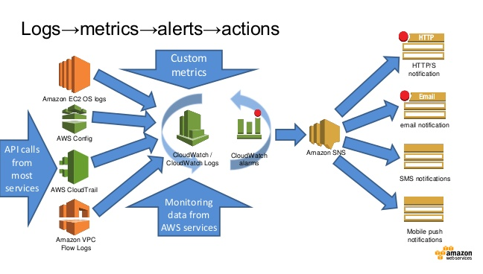
AWS Cloud Watch
Notes:
Amazon CloudWatch monitors your Amazon Web Services (AWS) resources and the applications you run on AWS in real-time.
Use CloudWatch to collect and track metrics, which are the variables you want to measure for your resources and applications.
CloudWatch alarms send notifications or automatically make changes to the resources you are monitoring based on rules that you define.
Cloud Watch monitors the CPU usage and disk reads and writes of your Amazon Elastic Compute Cloud (Amazon EC2) instances and then use this data to determine whether you should launch additional instances to handle increased load.
You can also use this data to stop under-used instances to save money.
you can monitor your own custom metrics. With CloudWatch, you gain system-wide visibility into resource utilization, application performance, and operational health
Cloud resources and the applications you run on AWS. You can use Amazon CloudWatch to collect and track metrics, collect and monitor log files, set alarms, and automatically react to changes in your AWS resources. Amazon CloudWatch can monitor AWS resources such as Amazon EC2 instances, Amazon DynamoDB tables, and Amazon RDS DB instances, as well as custom metrics generated by your applications and services, and any log files your applications generate. You can use Amazon CloudWatch to gain system-wide visibility into resource utilization, application performance, and operational health. You can use these insights to react and keep your application running smoothly.
Amazon CloudWatch provides a reliable, scalable, and flexible monitoring solution that you can start using within minutes. You no longer need to set up, manage, and scale your own monitoring systems and infrastructure.
Amazon CloudWatch enables you to monitor your AWS resources in near real-time, including Amazon EC2 instances, Amazon EBSvolumes, Elastic Load Balancers, and Amazon RDS DB instances. Metrics such as CPU utilization, latency, and request counts are provided automatically for these AWS resources. You can also supply your own logs or custom application and system metrics, such as memory usage, transaction volumes, or error rates, and Amazon CloudWatch will monitor these too.
With Amazon CloudWatch, you can access up-to-the-minute statistics, view graphs, and set alarms for your metric data to help you troubleshoot, spot trends, and take automated action based on the state of your cloud environment. Amazon CloudWatch functionality is accessible via API, command-line tools, the AWS SDK, and the AWS Management Console.
mazon CloudWatch automatically monitors Elastic Load Balancers for metrics such as request count and latency; Amazon EBS volumes for metrics such as read/write latency; Amazon RDS DB instances for metrics such as freeable memory and available storage space; Amazon SQS queues for metrics such as number of messages sent and received; and Amazon SNS topics for metrics such as number of messages published and delivered. No additional software needs to be installed to monitor other AWS resources.
Features & Benefits
Monitor Amazon EC2
View metrics for CPU utilization, data transfer, and disk usage activity from Amazon EC2 instances (Basic Monitoring) for no additional charge. For an additional charge, CloudWatch provides Detailed Monitoring for EC2 instances with higher resolution and metric aggregation. No additional software needs to be installed.
Learn more »
Monitor Other AWS Resources
Monitor metrics on Amazon DynamoDB tables, Amazon EBS volumes, Amazon RDS DB instances, Amazon Elastic MapReduce job flows, Elastic Load Balancers, Amazon SQS queues, Amazon SNS topics, and more for no additional charge. No additional software needs to be installed.
Learn more »
Monitor Custom Metrics
Submit Custom Metrics generated by your own applications via a simple API request and have them monitored by Amazon CloudWatch. You can send and store metrics that are important to your application’s operational performance to help you troubleshoot and spot trends.
Learn more »
Monitor and Store Logs
You can use CloudWatch Logs to monitor and troubleshoot your systems and applications using your existing system, application, and custom log files. You can send your existing system, application, and custom log files to CloudWatch Logs and monitor these logs in near real-time. This can help you better understand and operate your systems and applications, and you can store your logs using highly durable, low-cost storage for later access.
Learn more »
Set Alarms
Set alarms on any of your metrics to send you notifications or take other automated actions. For example, when a specific Amazon EC2 metric crosses your alarm threshold, you can use Auto Scaling to dynamically add or remove EC2 instances or send you a notification.
Learn more »
View Graphs and Statistics
Amazon Cloudwatch Dashboards enable you to create re-usable graphs of AWS resources and custom metrics so you can quickly monitor operational status and identify issues at a glance. Metric data is kept for a period of two weeks enabling you to view up to the minute data and also historical data. Amazon CloudWatch can load all the metrics in your account for search and graphing with the AWS Management Console. This includes logs, AWS resource metrics, and application metrics that you provide.
Learn more »
Monitor and React to Resource Changes
CloudWatch Events provides a stream of events describing changes to your AWS resources. You can easily build workflows that automatically take actions you define, such as invoking an AWS Lambda function, when an event of interest occurs.

Slide 41
AWS Cloud Front
Cloud-based content distributing network enables you to place the content at the edges of the network for rapid delivery.
Place the contents in S3 and run the application from anywhere and the content is moved to where the application is (to the edges).
Video Link https://www.youtube.com/watch?v=_oTj_3o1ceE
Notes:
Amazon CloudFront content delivery network (CDN) is a web service for content delivery. Amazon CloudFront makes your website's dynamic, static, and streaming content available from a global network of edge locations. When a visitor requests a file from your website, he or she is invisibly redirected to a copy of the file at the nearest edge location, which results in faster download times than if the visitor had accessed the content from a data center farther away. Amazon CloudFront caches content at edge locations for a period of time that you specify.
Amazon CloudFront supports all files that can be served over HTTP. This includes dynamic web pages, such as HTML or PHP pages, any popular static files that are a part of your web application, such as website images, audio, video, media files or software downloads. For on-demand media files, you can also choose to stream your content using Real-Time Messaging Protocol (RTMP) delivery. Amazon CloudFront also supports delivery of live media over HTTP.
Amazon CloudFront has two pricing components: regional data transfer out (per GB) and requests (per 10,000). Note that it is often cheaper (as well as faster) to deliver popular content from Amazon S3 through Amazon CloudFront rather than directly from Amazon S3.

Slide 42
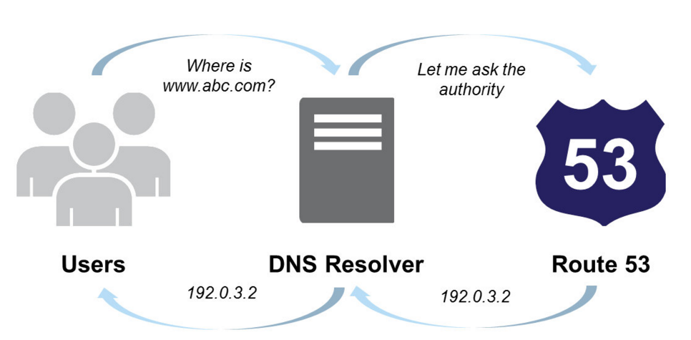
AWS Route 53
Notes:
Route 53 is a highly available and scalable cloud Domain Name System (DNS) web service. It is designed to give developers and businesses an extremely reliable and cost effective way to route end users to Internet applications by translating names like www.example.com into the numeric IP addresses like 192.0.2.1 that computers use to connect to each other.
Amazon Route 53 effectively connects user requests to infrastructure running in AWS – such as Amazon EC2 instances, Elastic Load Balancing load balancers, or Amazon S3 buckets – and can also be used to route users to infrastructure outside of AWS.

Slide 43
Amazon Relational Database Service (RDS)
Amazon Relational Database Service a web service that provides the capabilities of MySQL, Oracle, or Microsoft SQL Server relational database as a managed, cloud-based service
On-demand provisioning
No operating system for you to access
Platforms:
MySQL
Oracle
SQL Server
PostgreSQL
“Mostly” pre-configured
Basic monitoring / metrics provided
Automated backups
Automated recovery
User initiated “snapshots”
Automated replication
Software upgrades provided
Notes:
Amazon RDS makes it easy to set up, operate, and scale Oracle Database deployments in the cloud. With Amazon RDS, you can deploy multiple editions of Oracle Database in minutes with cost-efficient and re-sizable hardware capacity. Amazon RDS frees you up to focus on application development by managing time-consuming database administration tasks including provisioning, backups, software patching, monitoring, and hardware scaling.
Amazon RDS delivers high performance through a combination of configurable instances running on Amazon’s proven, world-class infrastructure with fully-automated maintenance and backup operations. Available database configurations range from a small instance (64-bit platform with 1.7 GB of RAM and 1 Amazon EC2 compute unit (ECU)) up to a quadruple extra-large instance (64-bit platform with 68 GB of RAM and 26 ECUs).
Available database configurations range from a small instance (64-bit platform with 1.7 GB of RAM and 1 Amazon EC2 compute unit (ECU)) up to a quadruple extra-large instance (64-bit platform with 68 GB of RAM and 26 ECUs).
Amazon RDS Provisioned IOPS provides a high-performance storage option designed to deliver fast, predictable, and consistent performance for I/O intensive transactional database workloads. When creating a new DB instance using the Amazon RDS Provisioned IOPS storage, you can specify the IOPS your instance needs from 1,000 IOPS to 30,000 IOPS and Amazon RDS provisions that IOPS rate for the lifetime of the instance.

Slide 44
RDS Features and Functionality
Pre-configured Parameters
Monitoring and Metrics
Automatic Software Patching
Automated Backups
DB Snapshots
Push-Button Scaling
Automatic Host Replacement
Replication: two features
Multi-AZ Deployment, Read Replica
Notes:
Working with Amazon RDS
Amazon RDS allows you to use the AWS Management Console or a simple set of web services APIs to create, delete and modify relational database instances (DB Instances). You can also control access and security for your instance(s) and manage your database backups and snapshots. For a full list of the available Amazon RDS APIs, please see the Amazon RDS API Guide. Some of the most commonly used APIs and their functionality are listed below:
CreateDBInstance — Provision a new DB Instance, specifying the DB Engine (Oracle Database edition), license model, DB Instance class, storage capacity, DB Engine version (optional), character set (optional, default is AL32UTF8), the backup retention policy you wish to use, and whether you want to run the DB Instance as a Multi-AZ deployment. This one API call is all that’s needed to give you access to a running Oracle Database, with the software pre-installed and the available resource capacity you request.
ModifyDBInstance — Modify settings for a running DB Instance. This lets you use a single API call to scale the resources available to your DB Instance in response to the load on your database, or change how it is automatically backed up and maintained on your behalf. You can also use this API to gain optional control over how DB Engine versions are upgraded.
DeleteDBInstance — Delete a running DB Instance. With Amazon RDS, you can terminate your DB Instance at any time and pay only for the resources you used.
CreateDBSnapshot — Generate a snapshot of your DB Instance. You can restore your DB Instance to these user-created snapshots at any point, even to reinstate a previously deleted DB Instance.
RestoreDBInstanceToPointInTIme — Create a new DB Instance from a point-in-time backup. You can restore to any point within the retention period you specified, usually up to the last five minutes of your database’s usage.
https://aws.amazon.com/rds/oracle/details
Amazon RDS offers a tiered pricing structure, based on the size of the database instance, the deployment type (Single-AZ/Multi-AZ), and the AWS region. Pricing for Amazon RDS is based on several factors: the DB instance hours (per hour), the amount of provisioned database storage (per GB-month and per million I/O requests), additional backup storage (per GB-month), and data transfer in / out (per GB per month). Pricing information can be found at Amazon Relational Database Service Pricing.

Slide 45
Multi-AZ Deployment
Availability Zones: are distinct locations within a Region that are engineered to be isolated from failures in other Availability Zones.
Run a DB Instance as a Multi-AZ deployment, the “primary” serves database writes and reads. Amazon RDS provisions and maintains a “standby” behind the scenes, which is an up-to-date replica of the primary. The standby is “promoted” in failover scenarios. After failover, the standby becomes the primary and accepts your database operations.

Slide 46
Oracle Deployment options
RDS
Quick provisioning
“Easy” management
Simple environment setup
Simplified replication strategy
No OS-level control
Limited granular fine tuning
Limited platform / versions
EC2+Database
You manage it yourself
OS & storage overhead
Software / version management
Configuration
Usually more costly
More control over config / performance
Allows more complex setups

Slide 47
Scalability- Scale Up vs. Scale Out
Scale Up/Vertical Scaling
Select next available configuration (EC2, RDS)
Relatively simple but limited scalability
Scale Out/Horizontal Scaling
Add additional resources
Complicated but high scalability
RDS Read replicas

Slide 48
RDS Limitation
Failovers are NOT instant.
Can take up to 6 minutes. Maybe more, depending on database size
Only limited platforms / versions are supported.
Upgrades / patching requires downtime.
You set an allowable maintenance window. Amazon will upgrade sometime during that window.
Can suffer from “noisy neighbor” syndrome.
Performance issues are sometimes hard to pinpoint
Master-Master replication is NOT supported

Slide 49


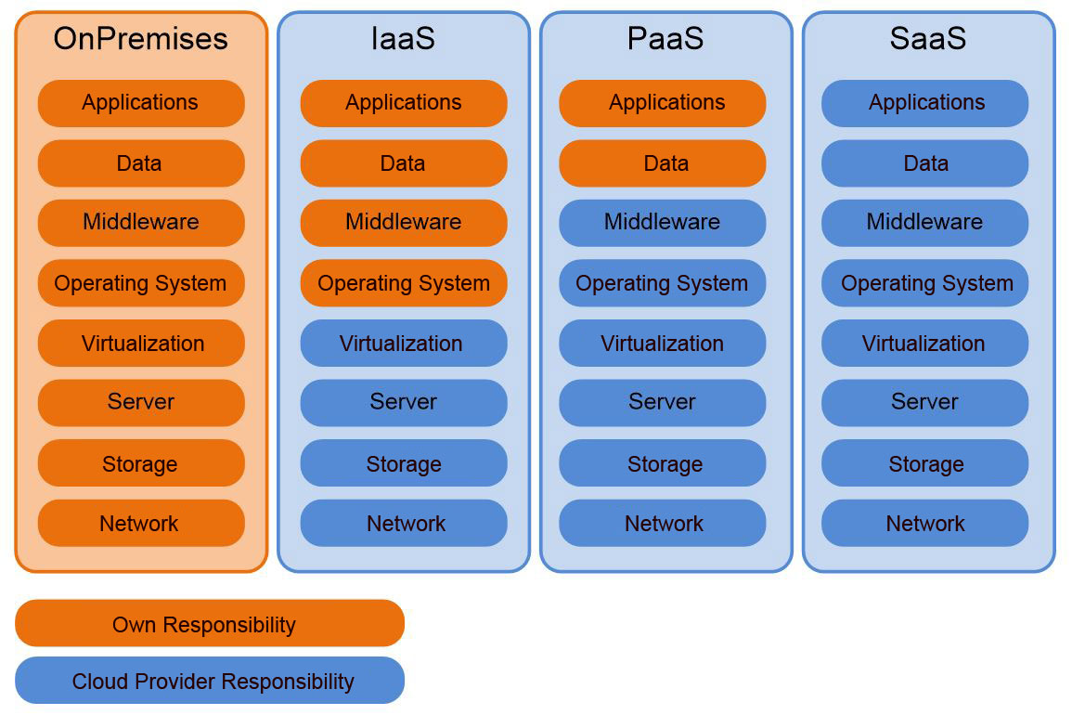
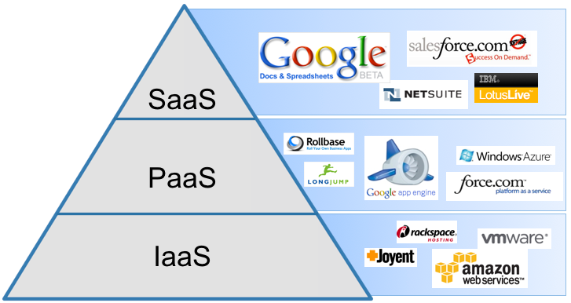
heard of 3 models of Cloud Computing?
Yes, Yes, IaaS, PaaS and SaaS

